Slide 1
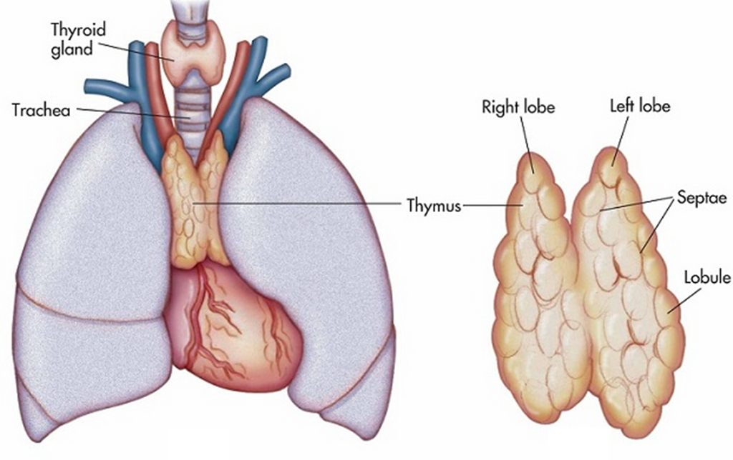
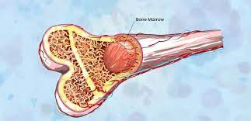
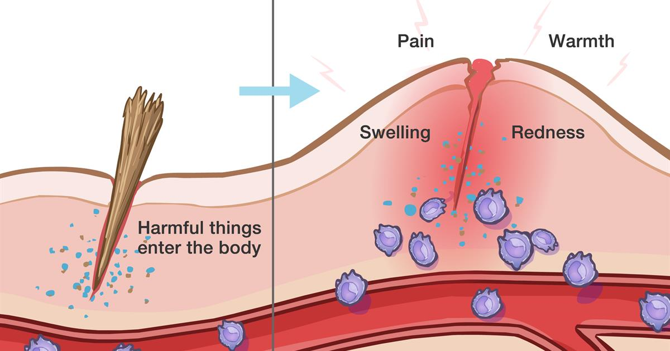
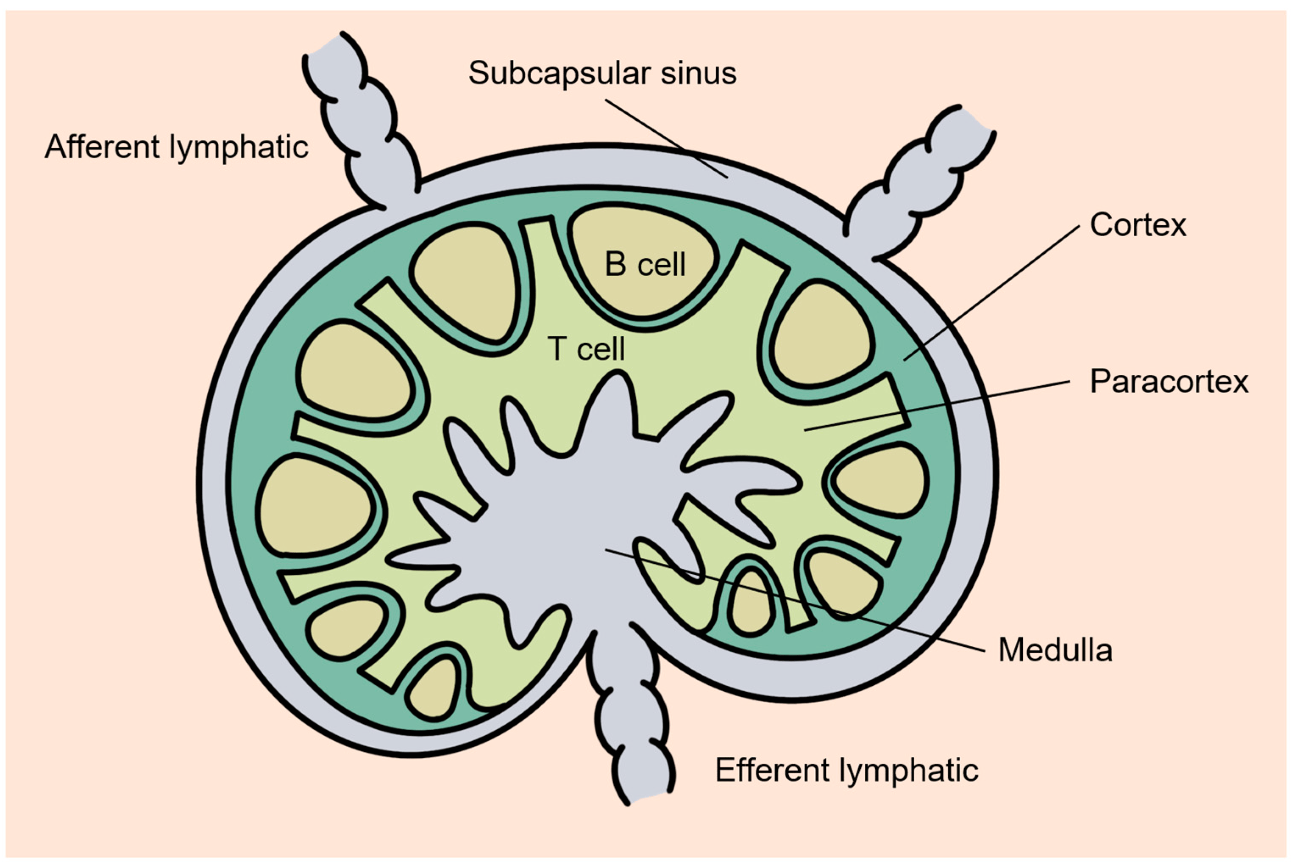
In the Thymus Stem Cells can Mature into Naïve T cells
Stem Cells Live in the Bone Marrow
Effector T cells Migrate to Sites of Inflammation
Naive T cells Circulate in the Blood and Peripheral Lympoid Tissue

Slide 2
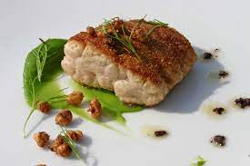



Everything You Need to Know About T cells
1. Where do they develop?
2. What is their function during an immune response?
3. How do they achieve specificity?
4. What are the different types of T cells?

Slide 3
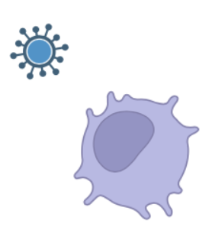
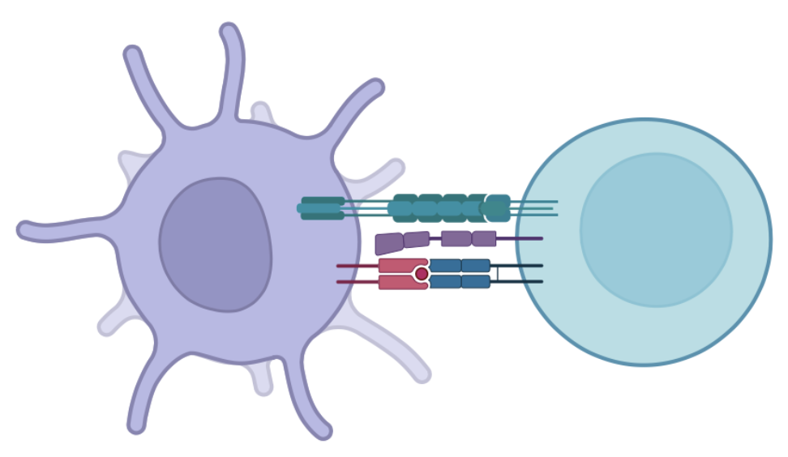
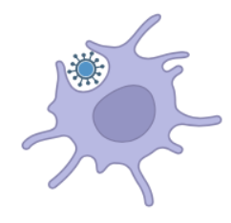

What do T cells do in Immune Responses?
Antigen Presenting Cells (APC) take up foreign organisms/pathogens and break them down into proteins in lysosomes.
APC
T cell
Pieces of these proteins called peptides are presented on the surface of the APC in either MHC Class I or Class II protein complexes
T cells use their T cell receptors to ‘scan’ these peptides to assess whether they are ‘self’ or ‘non-self’

Slide 4


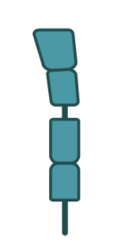

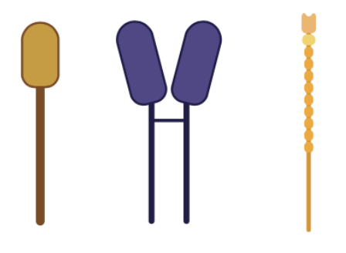
How to Build a Mature T cell
T Cell
First – We need at add a T cell receptor (TCR) so that the T cell can gain specificity
Second – We add CD4 or CD8 protein which determines whether a T cell binds to MHC Class II (CD4) or Class I (CD8) – this will determine the general ‘TYPE’ of cell it is.
Finally – We add receptors that direct T cells to blood and lymphoid tissues and allow them to interact with activated antigen presenting cells and infected target cells.

Slide 5
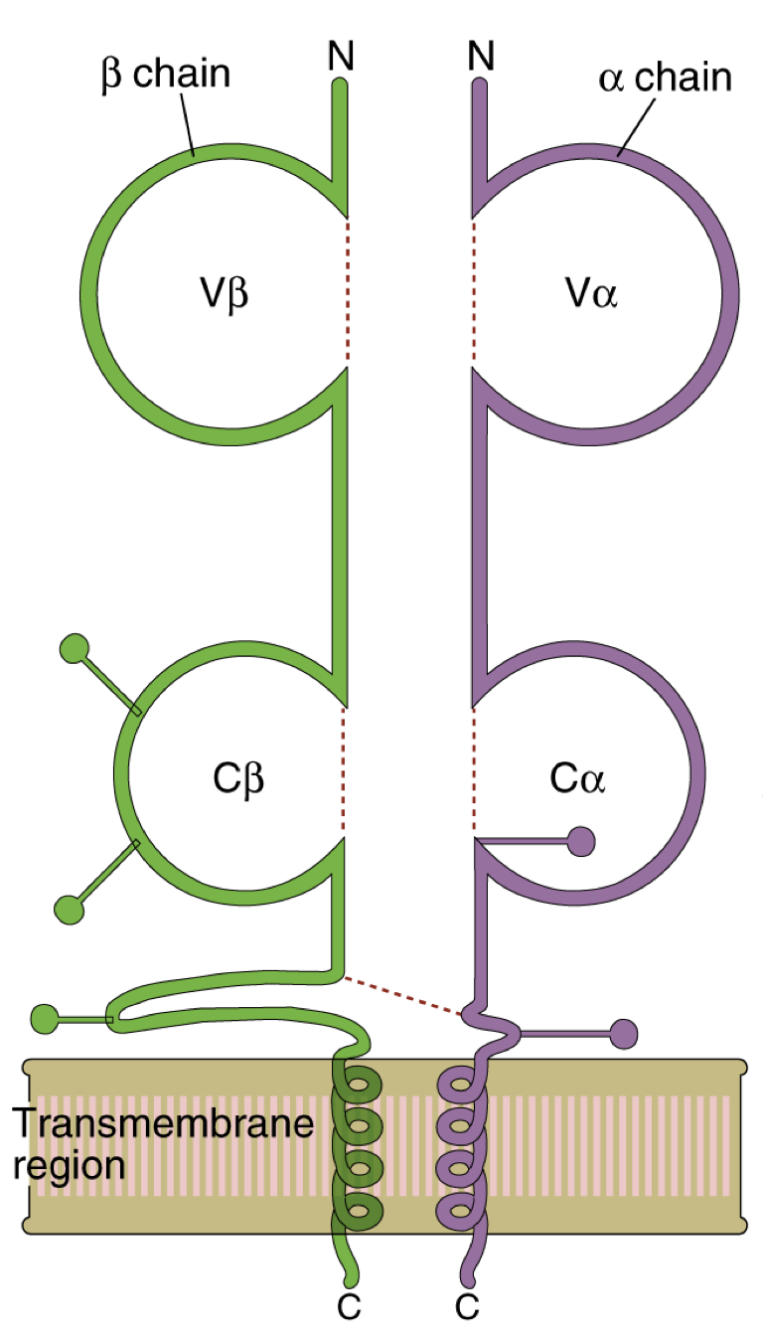
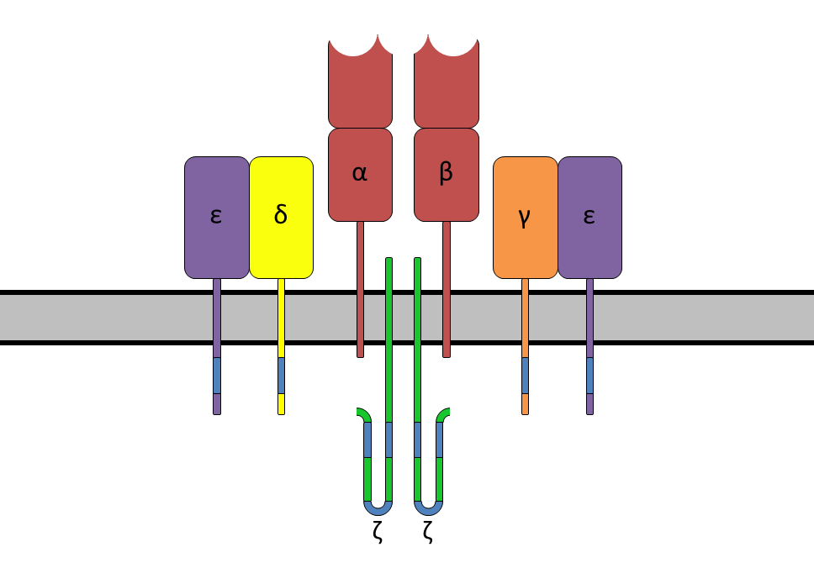
Beta Chain
Alpha Chain
T Cell Receptor Complex
Variable Region
Constant Region

Slide 6
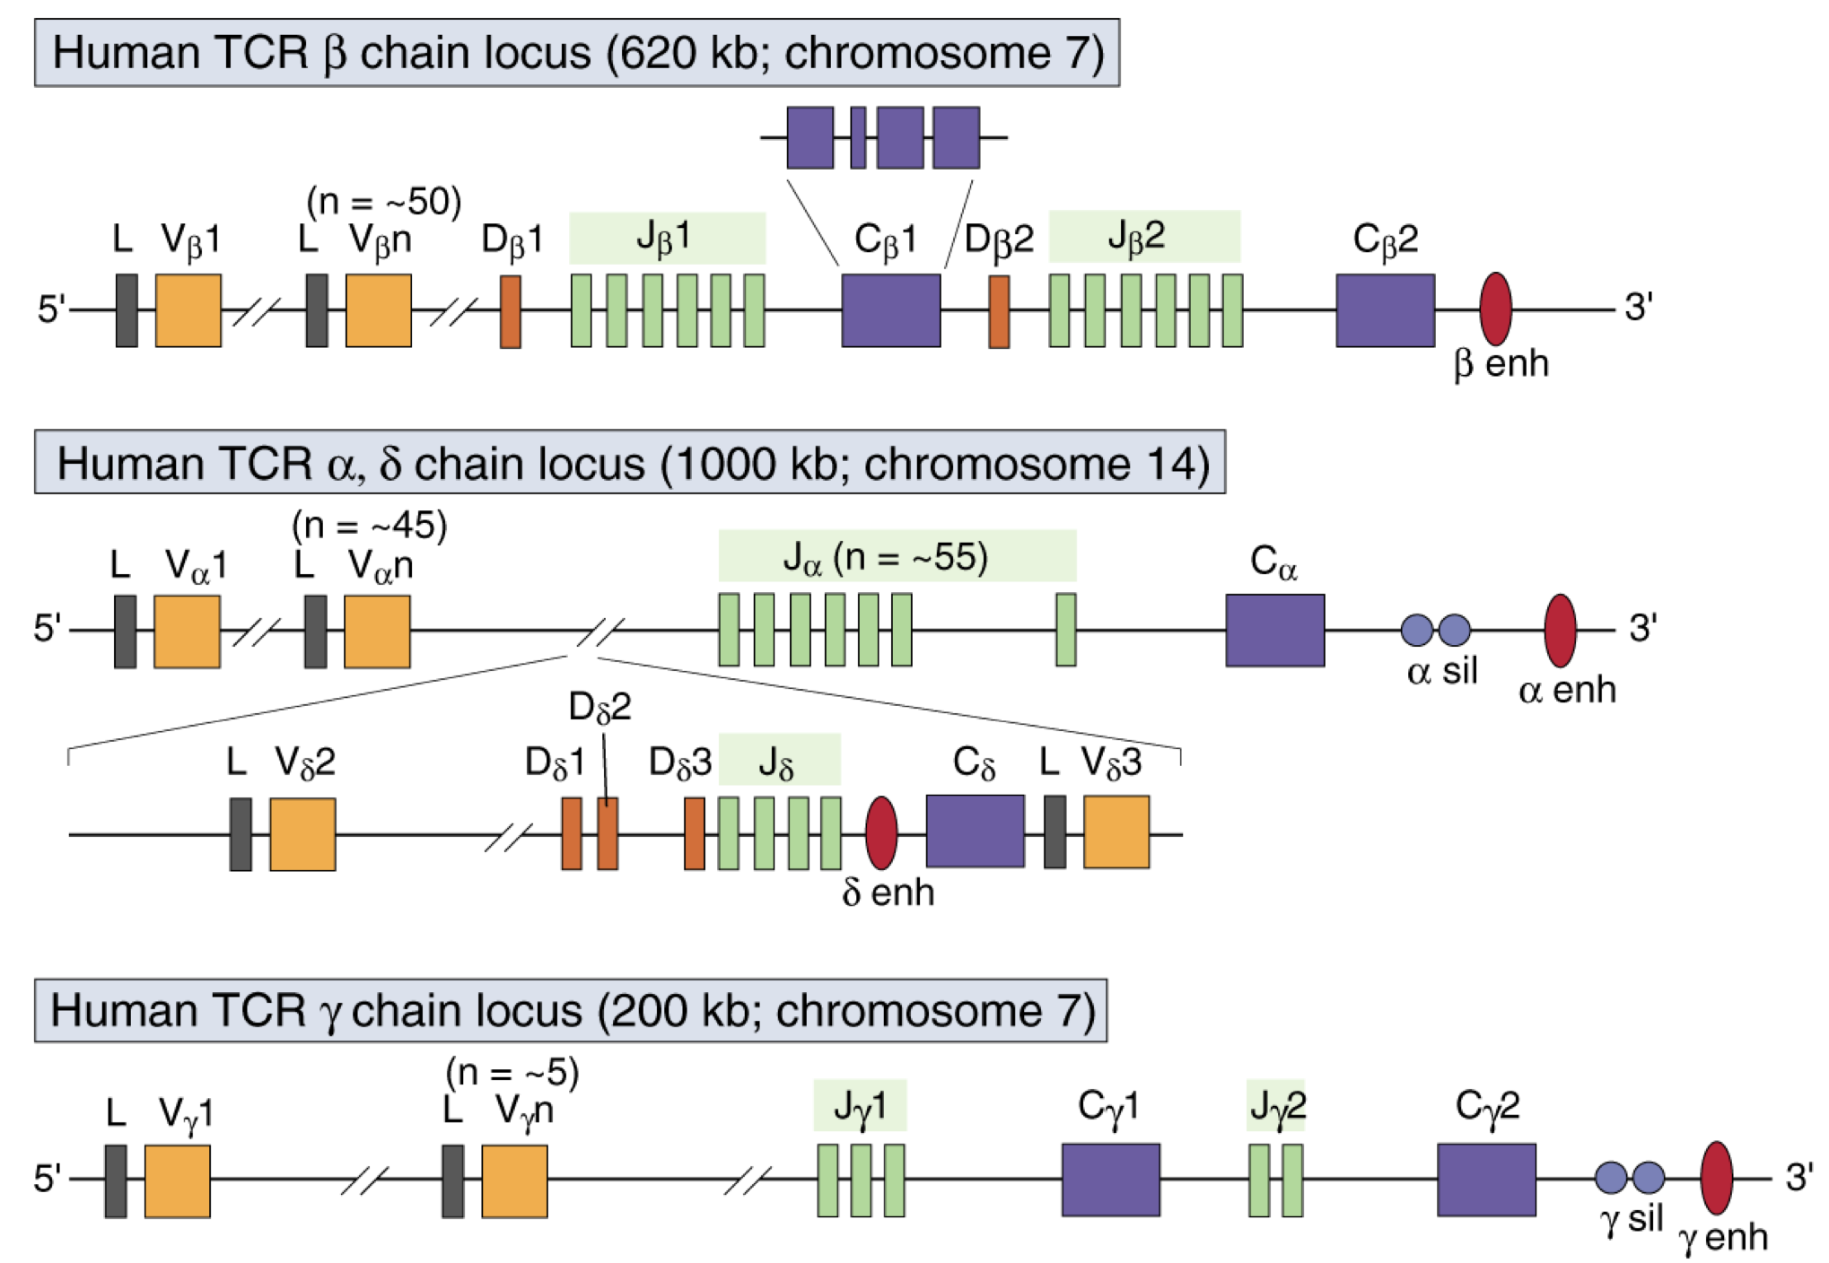

Don’t Freak out….

Slide 7
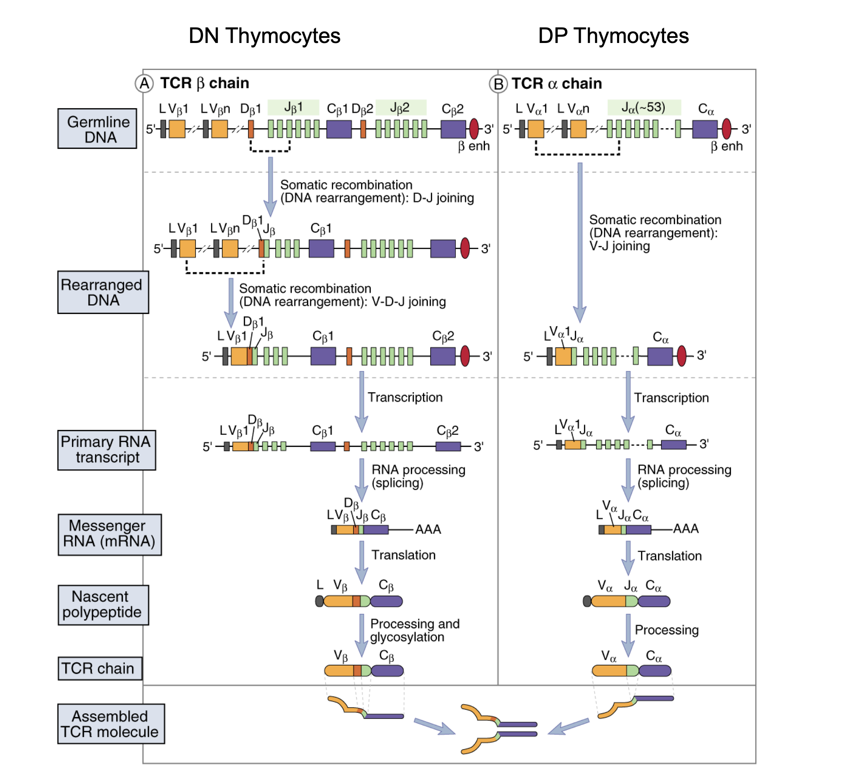
I stole this from a great set of lecture notes from UCSF professor Art Weiss who is one of the people who described how T cells work – you can find a link to those notes in the outline!

Slide 8
What are the basic components of a TCR?
Alpha Chain
V-Region
J-Region
Constant Region
Genetic recombination!
Post-transcriptional splicing!
Beta Chain
V-Region
D
J-Region
Constant Region
Genetic recombination!
Post-transcriptional splicing!
RAG1 and RAG2 join random segments together and TdT inserts random nucleotides in the joined regions!

Slide 9
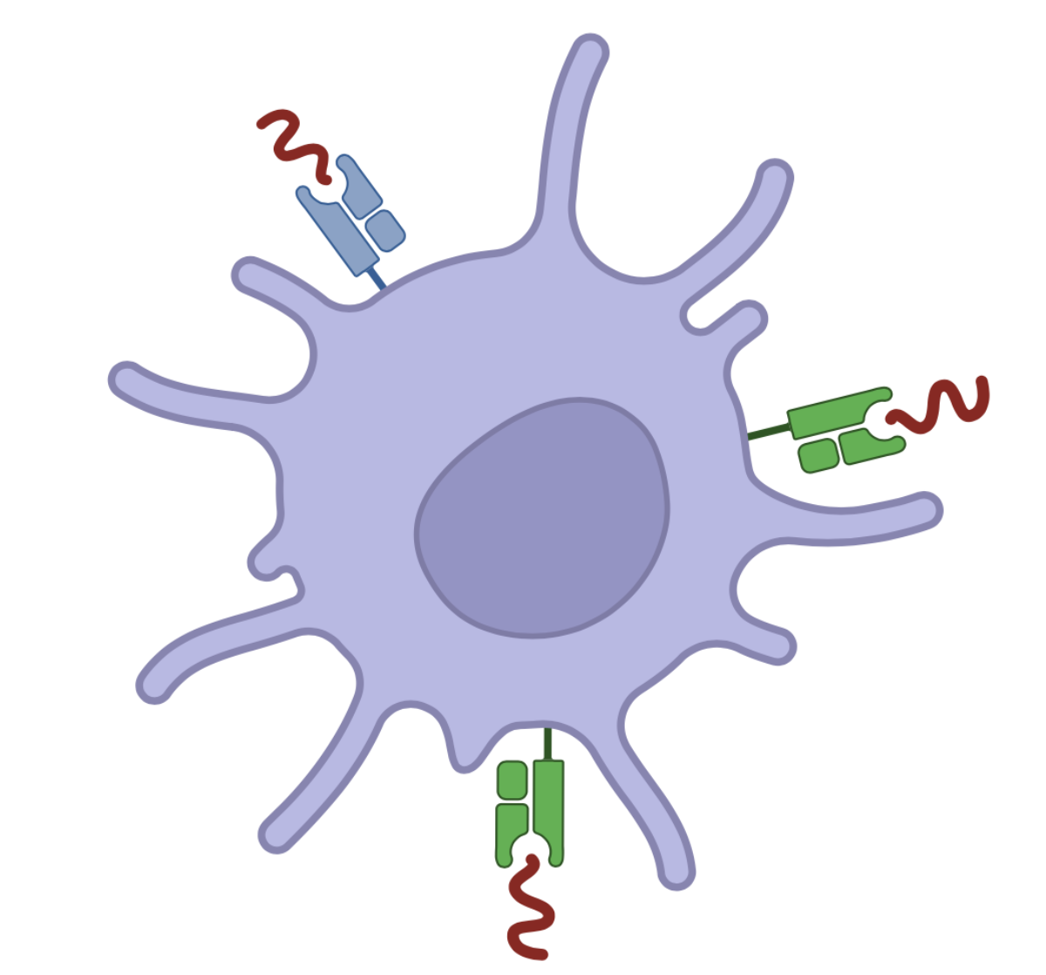
What are the key things to know about the TCR
T cells must be able to respond to specific antigens
AND – they must be ‘tolerant’ of any antigens that are not dangerous
So we have to build a system from scratch that recognizes ALL foreign dangerous proteins while ignorning normal/healthy proteins

Slide 10
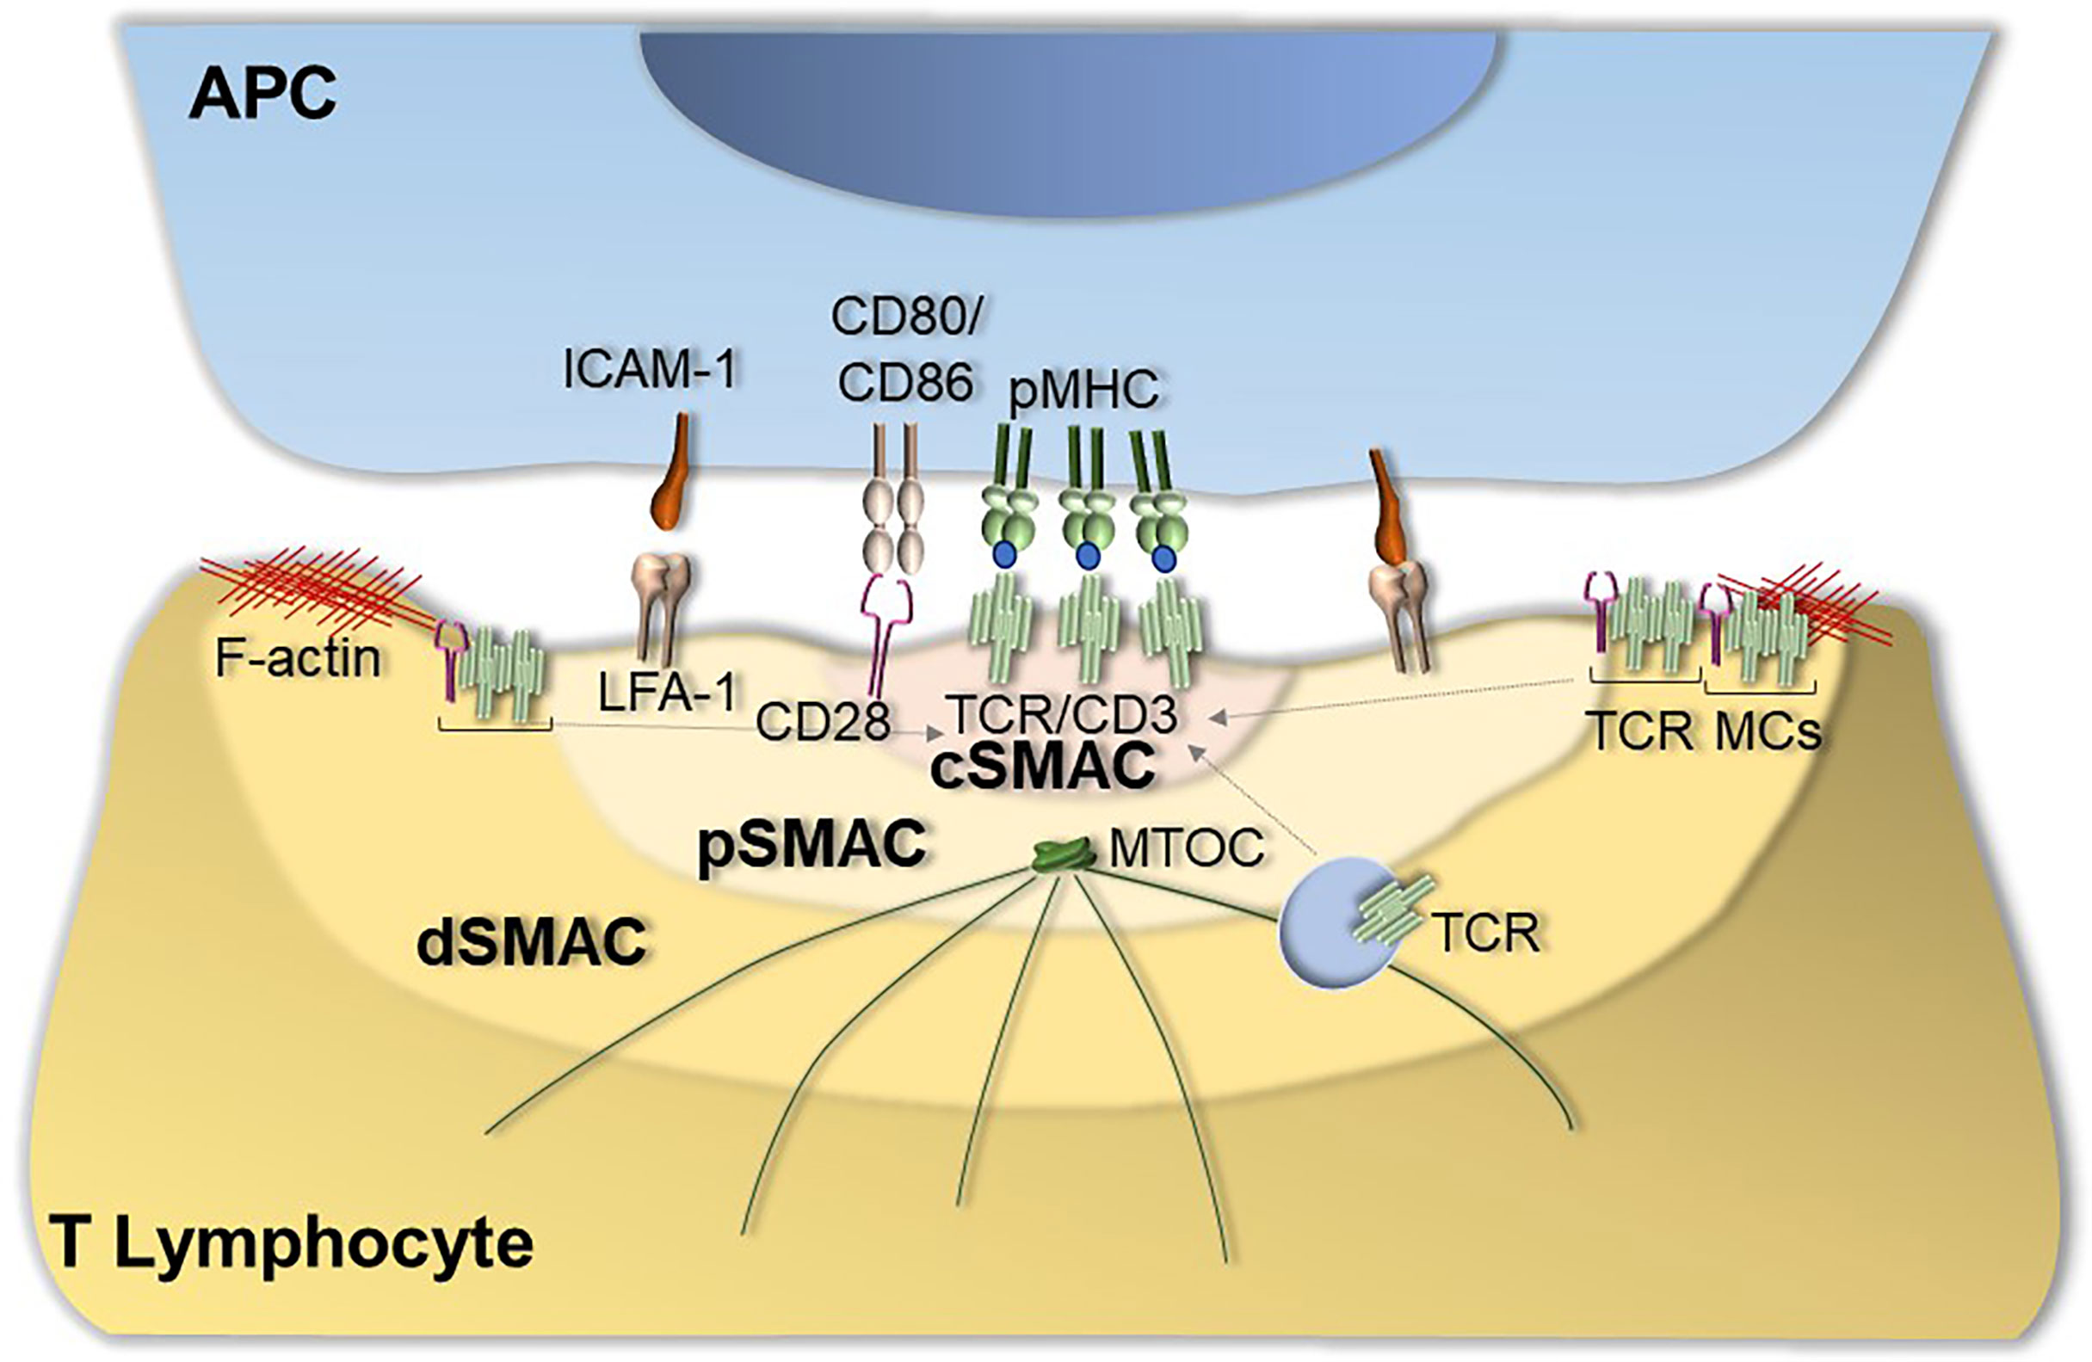
The Way that a TCR Signals a ‘Positive’ Signal is Because of High Affinity Engagement with MHC-Peptide Complexes
KEY POINT: Specificity of the TCR is dependent on the strength it binds to a combination of MHC and peptide

Slide 11
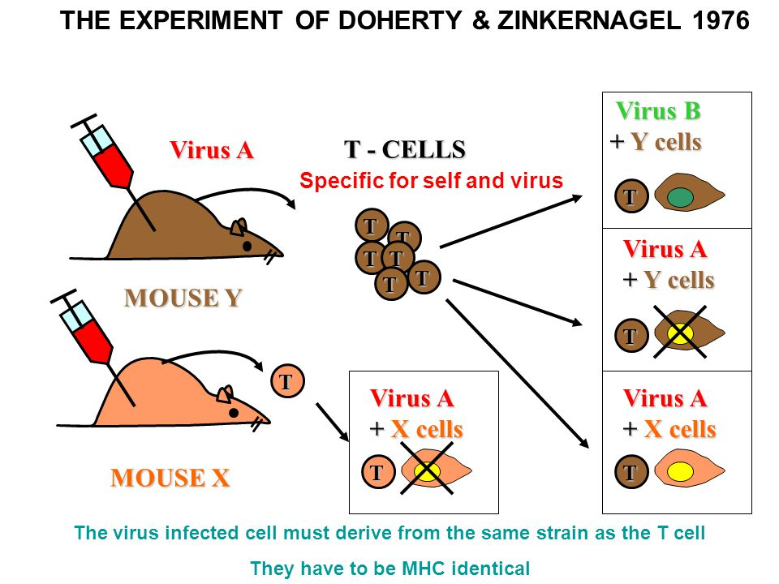
T cells recognize FOREIGN PEPTIDE (antigen) in the context of SELF MHC
Link to this paper in your outline (online)

Slide 12
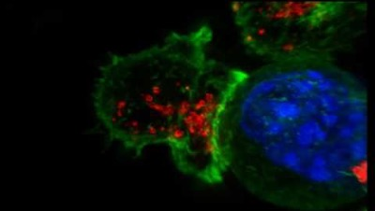
Tolerance and Aggression in T cell Biology

Slide 13
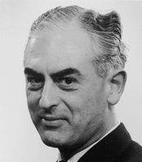
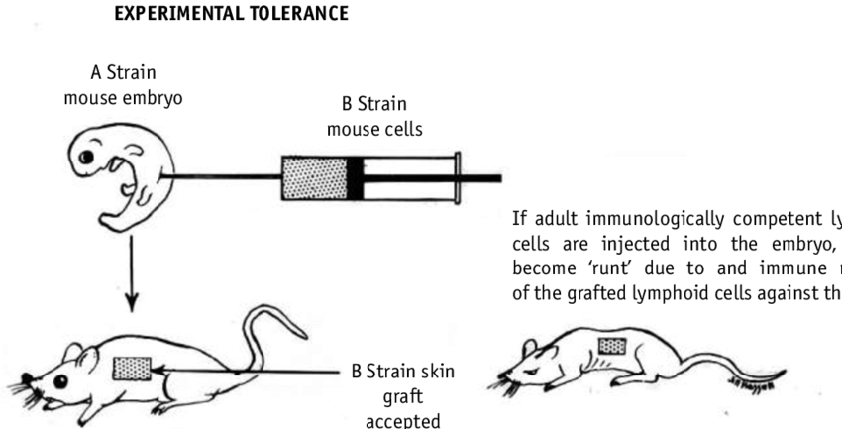
The Birth of the Concept of Immunological Tolerance
Sir Peter Medawar
British Transplant Surgeon
Nobel Laureate 1960
‘For the discovery of aquired immunological tolerance’

Slide 14
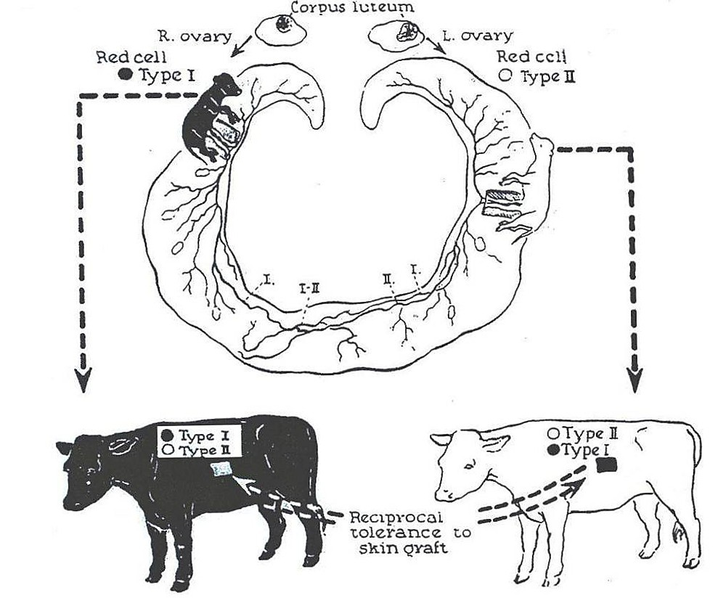
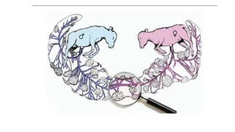
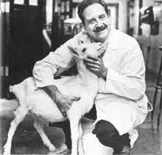
A peculiar observation while studying cattle infertility due to hormonal exchange in utero
Ray Owen

Slide 15
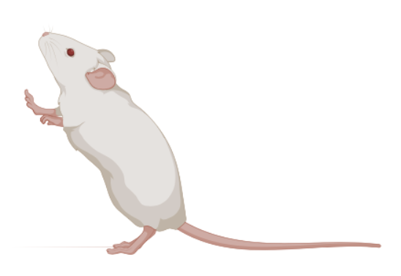
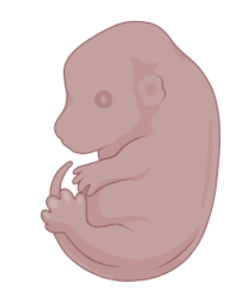
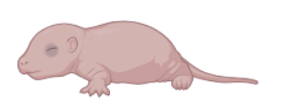
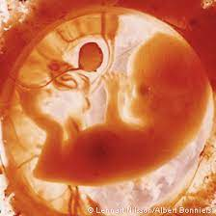
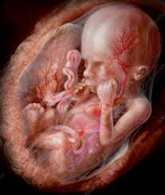
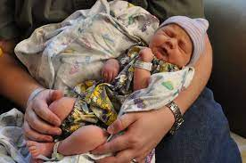

Adult
14 days p.c.
Neonatal
No Mature Typical T cells
First CD4/CD8 Naïve T cells appear at Day 0-3 post birth
Full repertoire of Naive T cells in Adults
2-3 months
4-8 months
Neonatal
‘Adult’
Active Thymus at 10g.w. in utero
Peripheral Fetal T cells including ’activated’ cells
At 18-24g.w. in utero!
Highly developed but ’immature’ T cell population at birth
Full repertoire of Naive T cells in Adults

Slide 16
T Cell Development
T Cell
First – We need at add a T cell receptor (TCR) so that the T cell can gain specificity
This T cell receptor has to meet these requirements:
It has to be able to bind to the MHC molecules found in the organism (Huge diversity of MHC among individuals)
It has to NOT be activated by ‘self’ MHC molecules
It needs to be able to potentiall recognize foreign peptide on self MHC molecules
It must NOT react to ‘self’ peptides on ‘self’ MHC

Slide 17
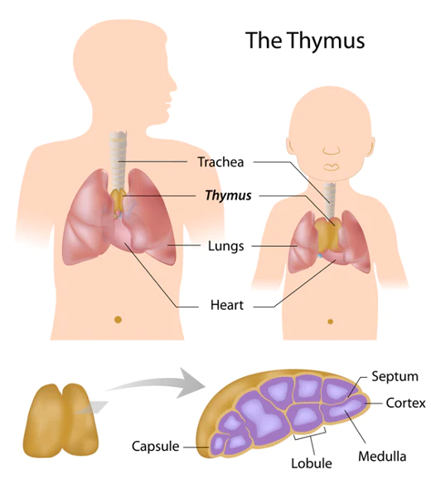
The Thymus is ’School’ for Developing T cells – If you remove the Thymus you have NO conventional T cells!
Just like school – the thymus is more important/active very early in life and goes away in adulthood.

Slide 18
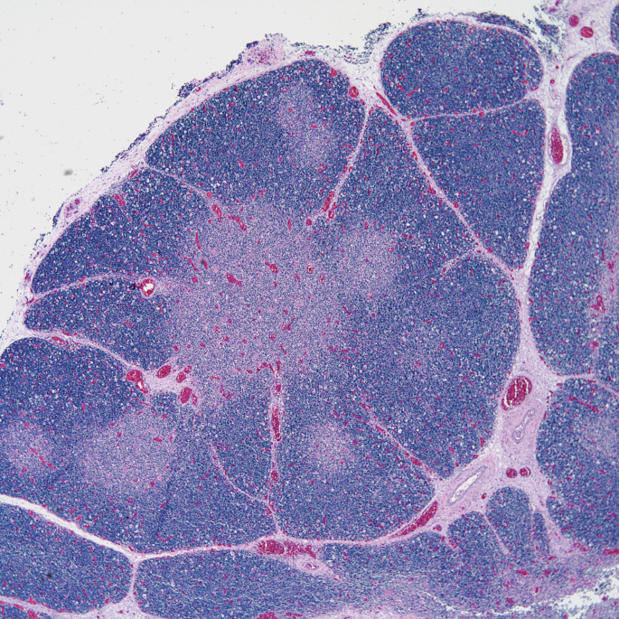
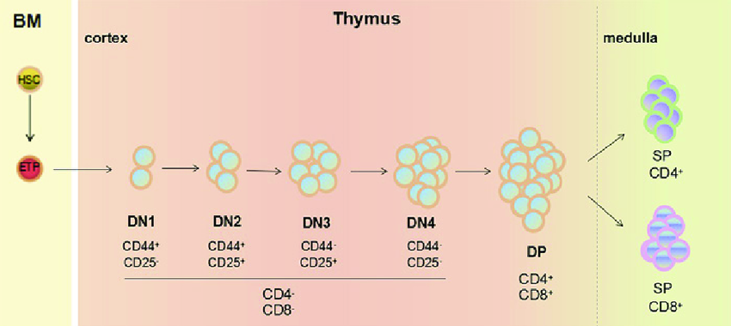
You can break the thymus into 2 categories:
Cortical Regions: Densely packed with immature thymocytes (double negative (DN) and double positive (DP))
(2) Medullary Regions: More diffuse regions containing more mature thymocytes (single positive (SP))
DN
SP
DP
DP
SP
DN
DN
DP
SP
SP
SP
DN

Slide 19
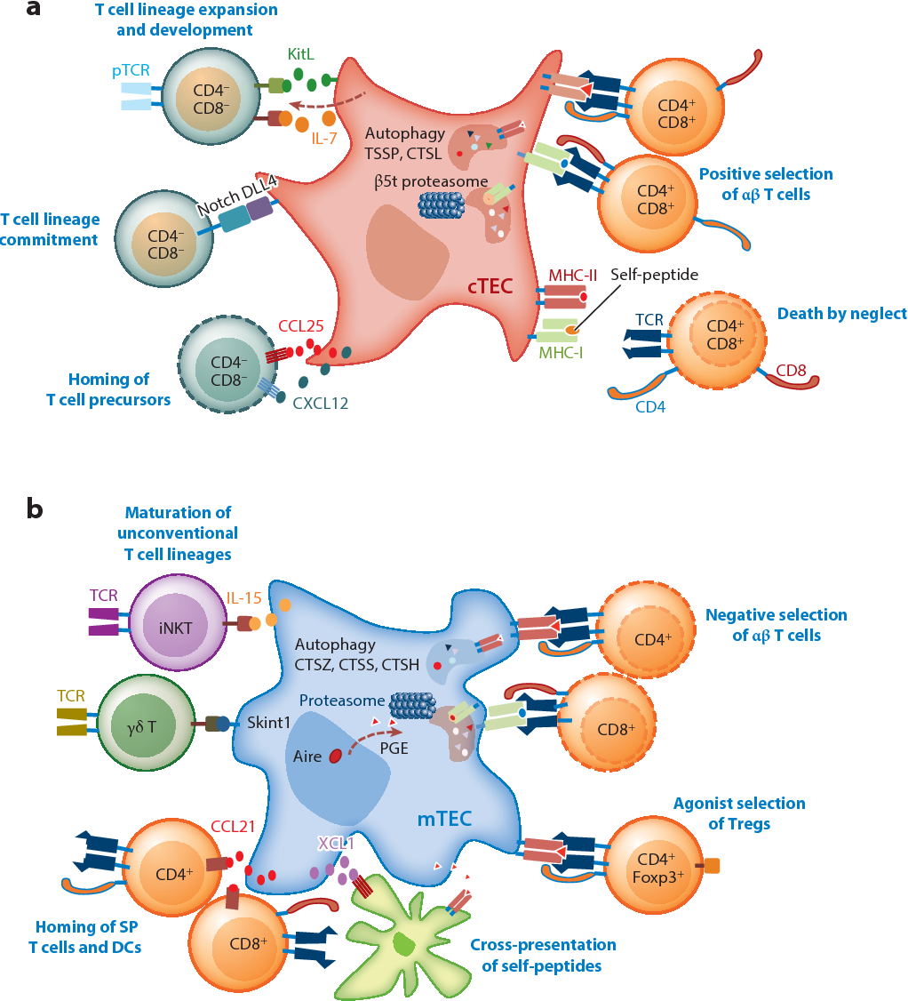
Thymocytes are selected on specialized epithelial cells and Antigen Presenting Cells
Positive Selection – CORTEX – T cells ‘audition’ rearranged TCRs to see if they can bind self MHC. cTEC have special proteasomes which present different peptides for positive selection.
If they don’t receive a signal: ‘Death by Neglect’
Negative Selection – MEDULLA – T cells are test TCRs to look for possibly ‘self reactivity’ to endogenous protein antigens. mTEC have special machinery to present a diverse array of ‘tissue specific antigens’ (like insulin)
If they react strongly: ‘Death by Negative Selection’

Slide 20
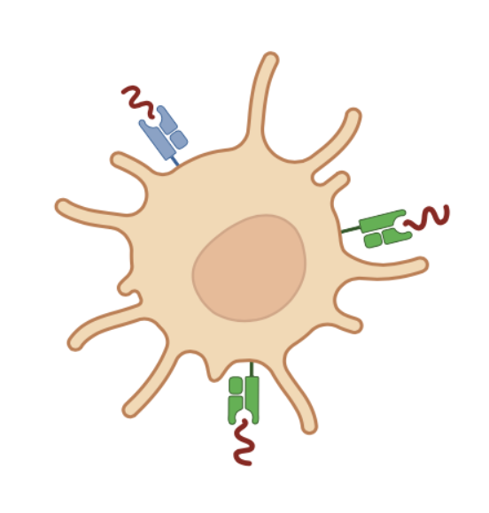

Positive Selection: Grade School!
Add a TCR!
DN T
You have 2 copies of Chr7 and Chr14 -> Two tries to make a productive TCR combo!
= No Signal to the T cell? DEATH!
= Signal through TCR? SURVIVE to next game!

Slide 21
Negative Selection: High School!
Test ‘Self’ Peptide Reactivity
SP Thymocyte
Naïve T cell
= Strong TCR activation? DEATH
= Weak/No Signal? SURVIVE and leave the thymus!

Slide 22
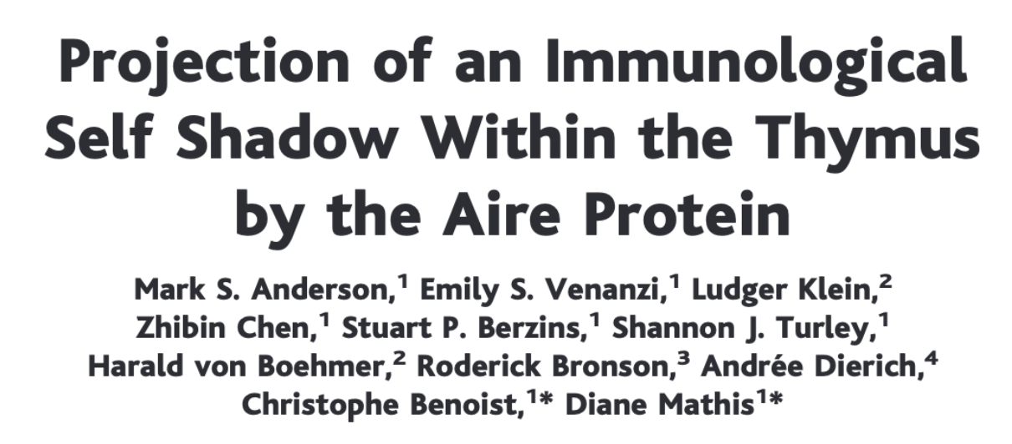
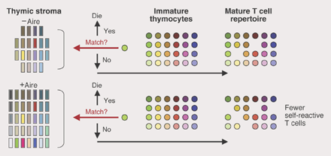
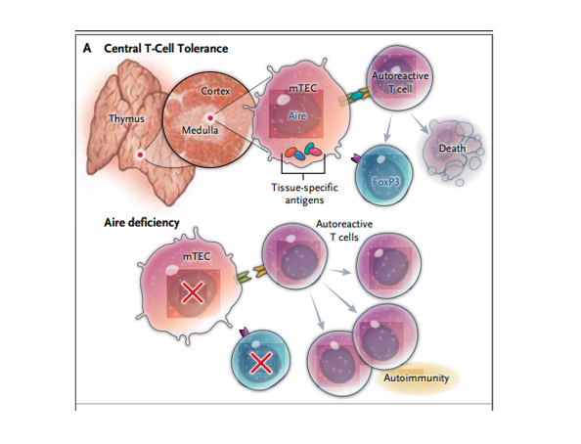
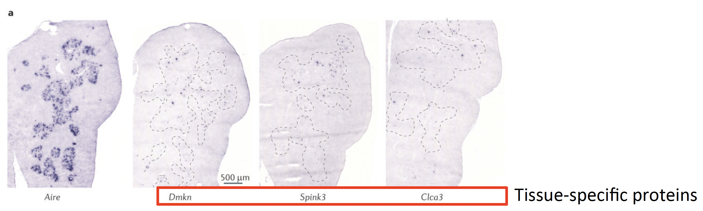

Slide 23
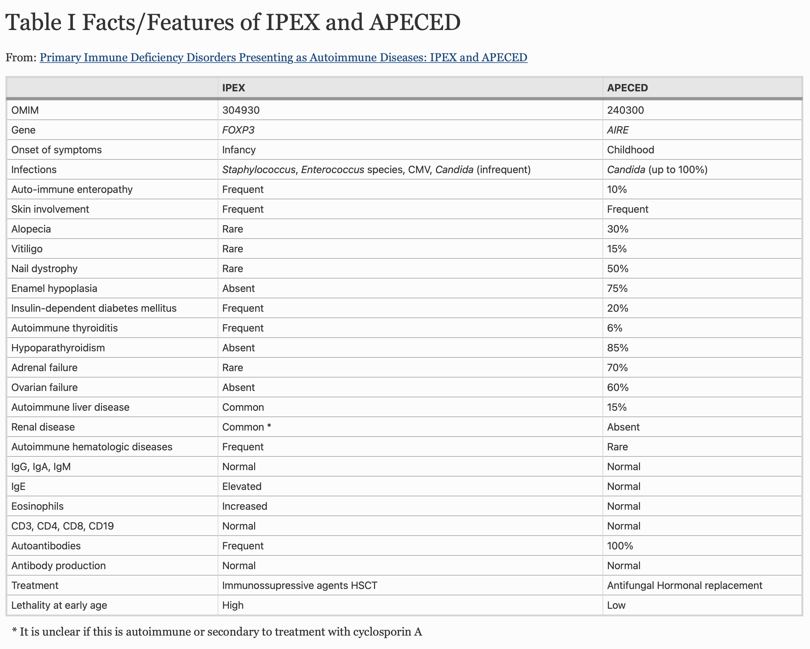
Two Genetic Diseases Which Cause Failure of T cell Tolerance:
IPEX: Dysfunctional Treg
APECED: Failed Negative Selection

Slide 24
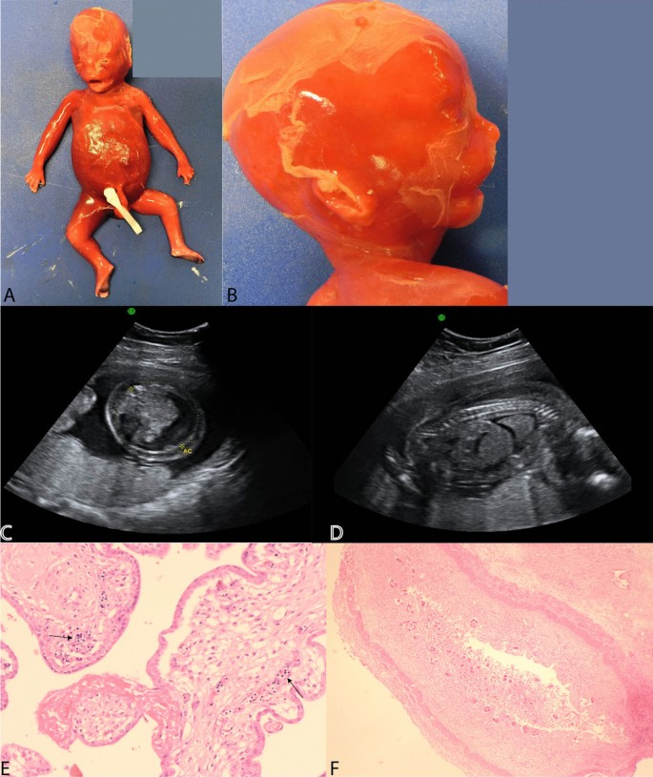
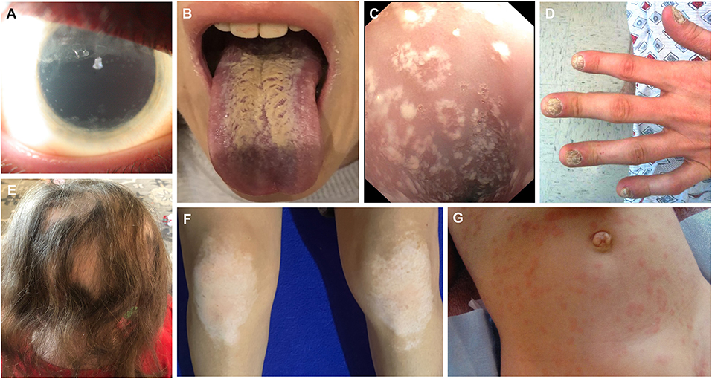
IPEX: No Tregs – Failure to Thrive
APECED: No Negative Selection – multiple autoimmune manifestations

Slide 25
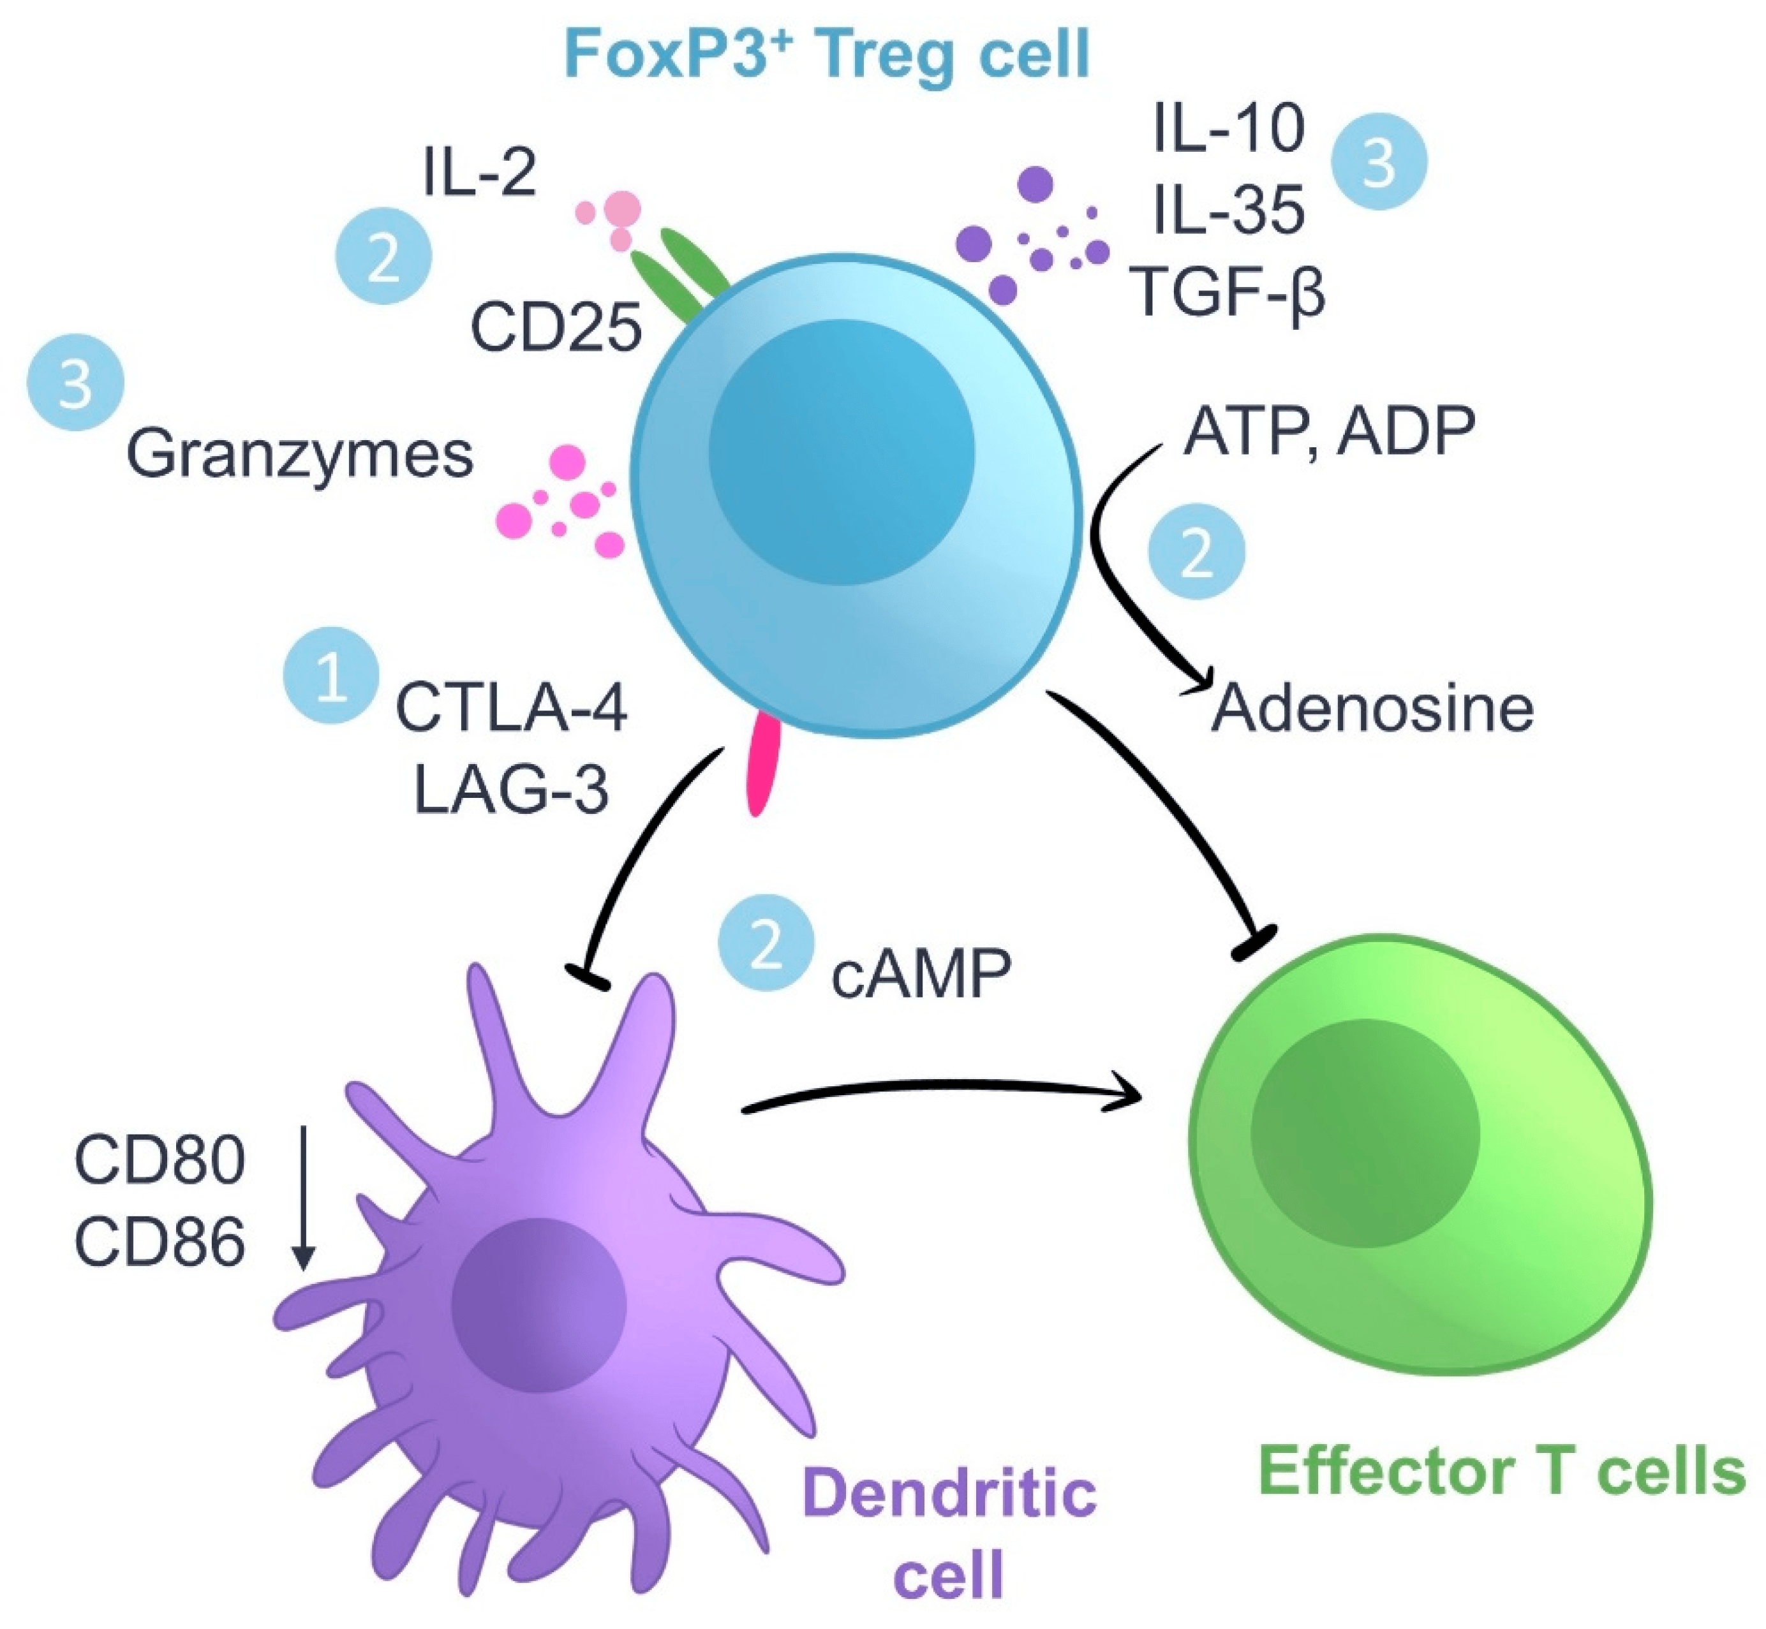
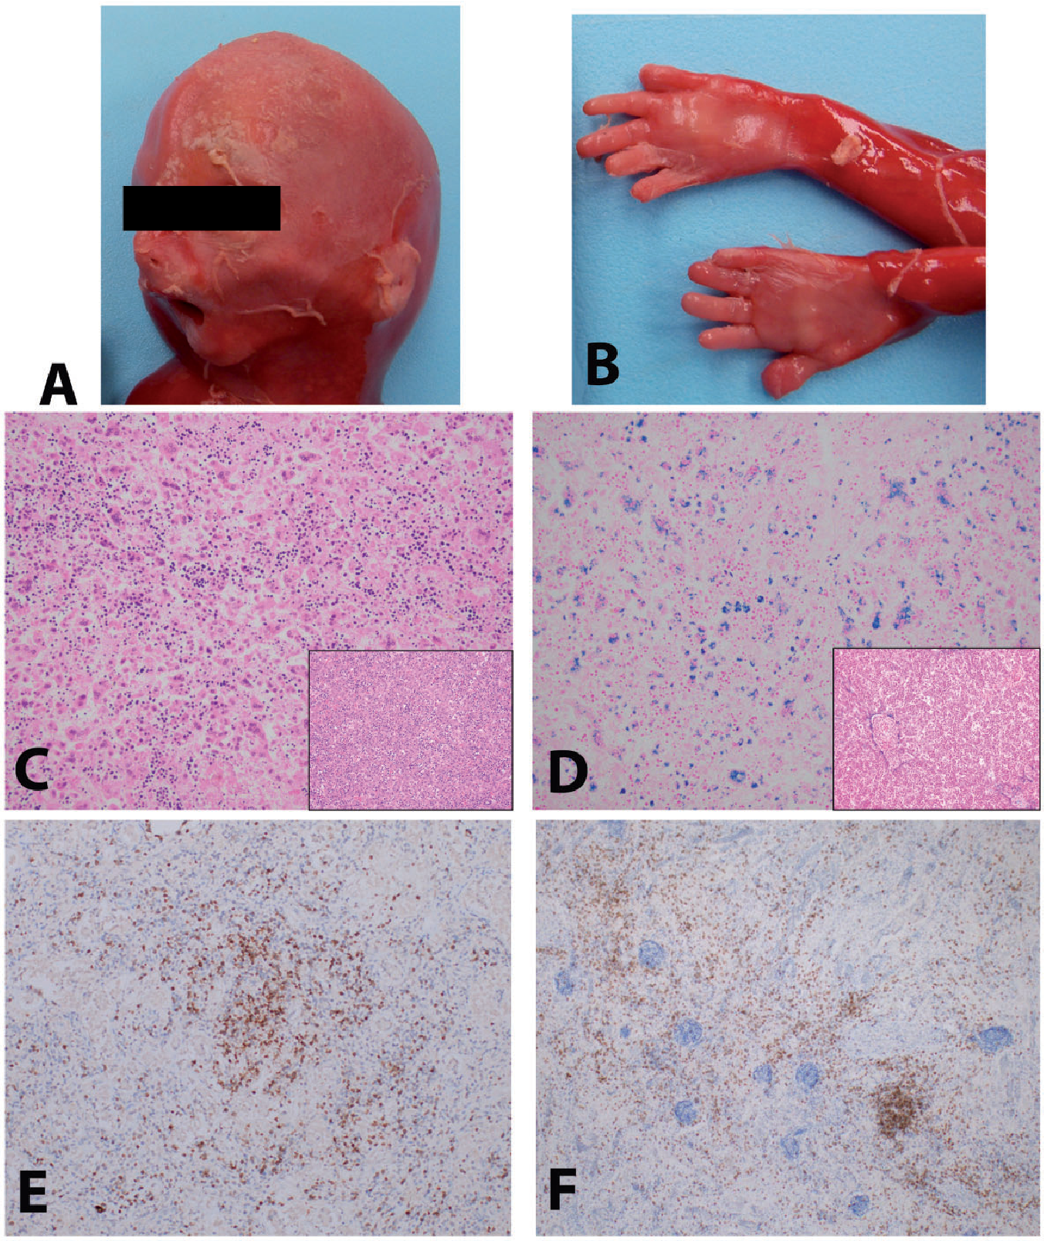
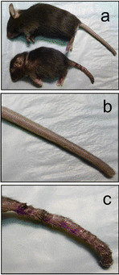
Let’s Talk about Treg Cells
WT
Scurfy
WT
Humans often fail to develop
Scurfy
Mice die at 3 weeks of age

Slide 26
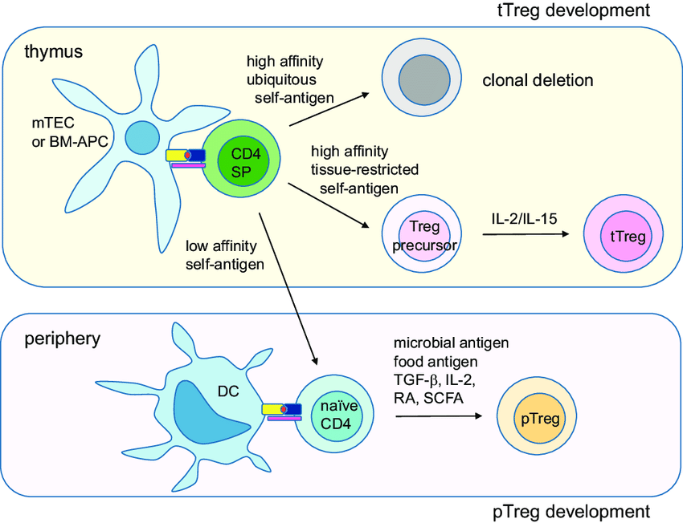
Treg can come from the thymus or be generated in the periphery –
Both processes typically involve upregulation of the transcription factor FOXP3 (the gene affected in IPEX/Scurfy)

Slide 27
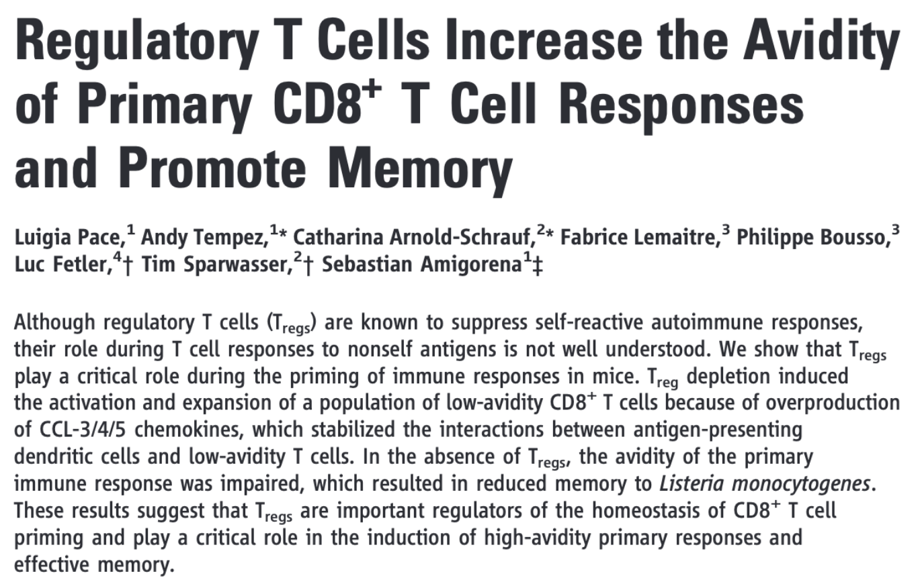
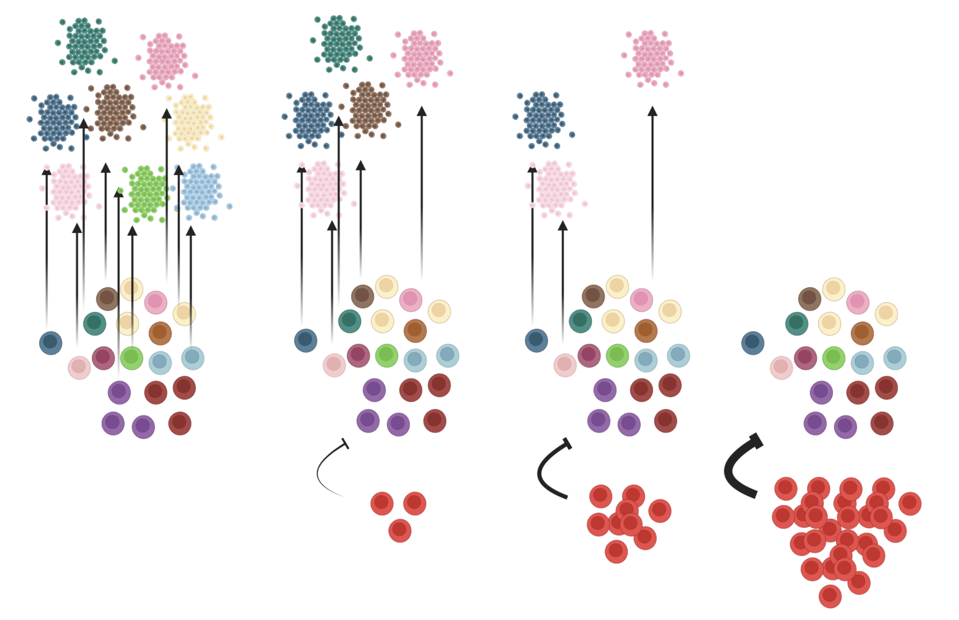
Naïve T cell clones
Activated T cells
Tregs

Slide 28
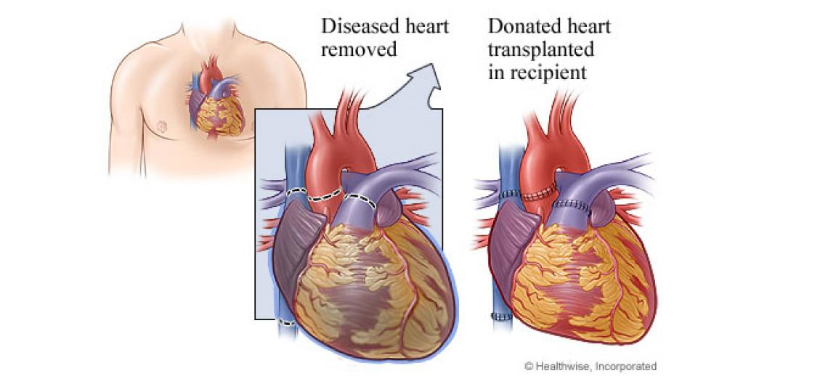
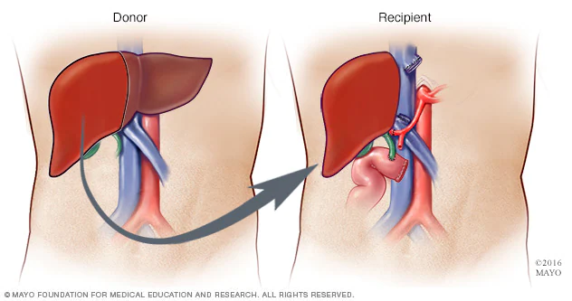
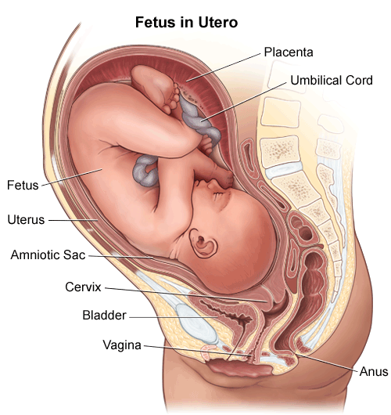

What do these scenarios have in common?

Slide 29


Placental Mammals Evolved a Mechanism to Generate Tregs to Sustain Allogeneic Pregnancy

Slide 30

Different Types of Mature T cells Exist – There are MANY and Growing… But These are Important Ones

Slide 31



How do you Generate an Effector or Memory T cell?
GROWTH FACTORS/CYTOKINES
COSTIMULATION
+
+
Naive Cell Type
Induce Transcription Factors and differentiation of specialized cell types
Specialized Effector or Memory T cell types

Slide 32
How do you Generate an Effector or Memory T cell?
TGFB +
COSTIMULATION
+
+
Naïve CD4 T cell
Induce Foxp3
Expression and Treg gene program
Peripheral CD4+Foxp3+
T regulatory cell

Slide 33
How do you Generate an Effector or Memory T cell?
TGFB + IL6
COSTIMULATION
+
+
Naïve CD4 T cell
Induce RORgt
Expression and Th17 gene program
CD4+ T helper 17 cell (Th17)

Slide 34



The Migration of T cells – Sphingosine Gradients Regulate Recirculation of Lymphocytes
Jason Cyster’s lab showed that S1PR1 blocks T cell recirculation through lymphoid tissues.

Slide 35





Chemokines Specify Positions of Immune Cells in Tissues

Slide 36


The Migration of T cells

Slide 37




James Allison – Nobel Prize in Medicine 2018

Slide 38
How to Build a Mature T cell
T Cell
TCR – Defines what antigen the T cell will ‘see’
CD4/CD8 – Defines what type of T cell it will be and what MHC it will engage with.
Costimulation/Adhesion/Chemokine Receptors – Defines how the T cell will become activated and where it will go.

Slide 39
Let’s Put it All Together…

